Slide 1
Supplemental document S2.
Genome-to-genome plots, produced with gggenomes (https://github.com/thackl/gggenomes), of selected P-Ps, phages and plasmids. Genes detected by P-P profiles are shown in green arrows.
Slide 2: Examples of hits (low confidence) with atypical sizes
Slide 3: cp32 elements with high, medium and low confidence levels
Slide 4: Detection of P1-like plasmids (false-positives) by tyPPing.
Slide 5: N15-like P-Ps with atypical sizes.
Slide 6: P1_1 low confidence with too-long size
Slide 7: P1_2 case (false positive) predicted by tyPPing in 05/23
Slide 8: Cases (low confidence) related to AB_1, detected by MM-GRC and not by tyPPing
Slide 9: SSU5_pHCM2-like P-P not detected by tyPPing
Slide 10: pSLy3-like P-P not detected by tyPPing

Slide 2
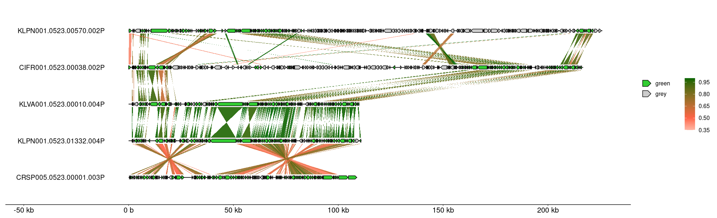

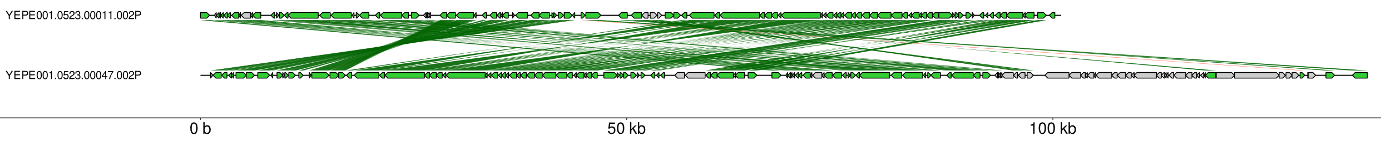
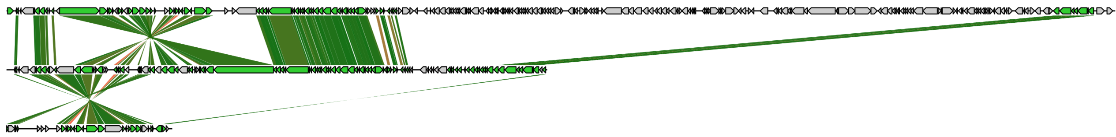
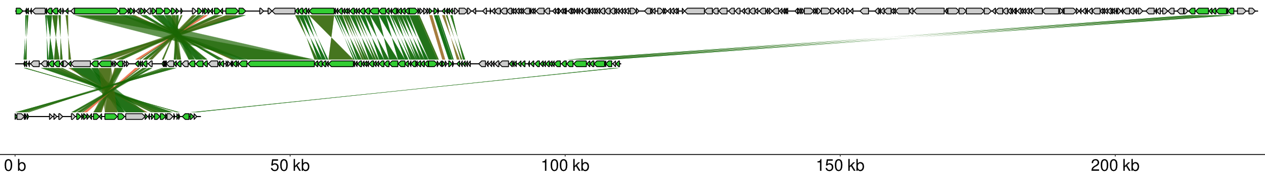
Examples of putative cases with atypical sizes.
A
Identity:
Conserved pMT1
NZ_CP045146
Other
wGRR = 0.96
NZ_CP010248
B
NZ_CP017778
wGRR = 0.59
Identity:
NZ_CP028550
Conserved pKpn
wGRR = 0.75
Other
NZ_CP027149
(A) Comparisons between a pMT1-like P-P (high confident, green box) and a long element with additional sequences (indicated with blue brackets). (B) Confident pKpn-like P-P (green box, NZ_CP028550) detected by tyPPing and MM-GRC. NZ_CP017778 and NZ_CP027149 have atypical genome sizes, whereas NZ_CP027149 was only detected by MM-GRC.

Slide 3
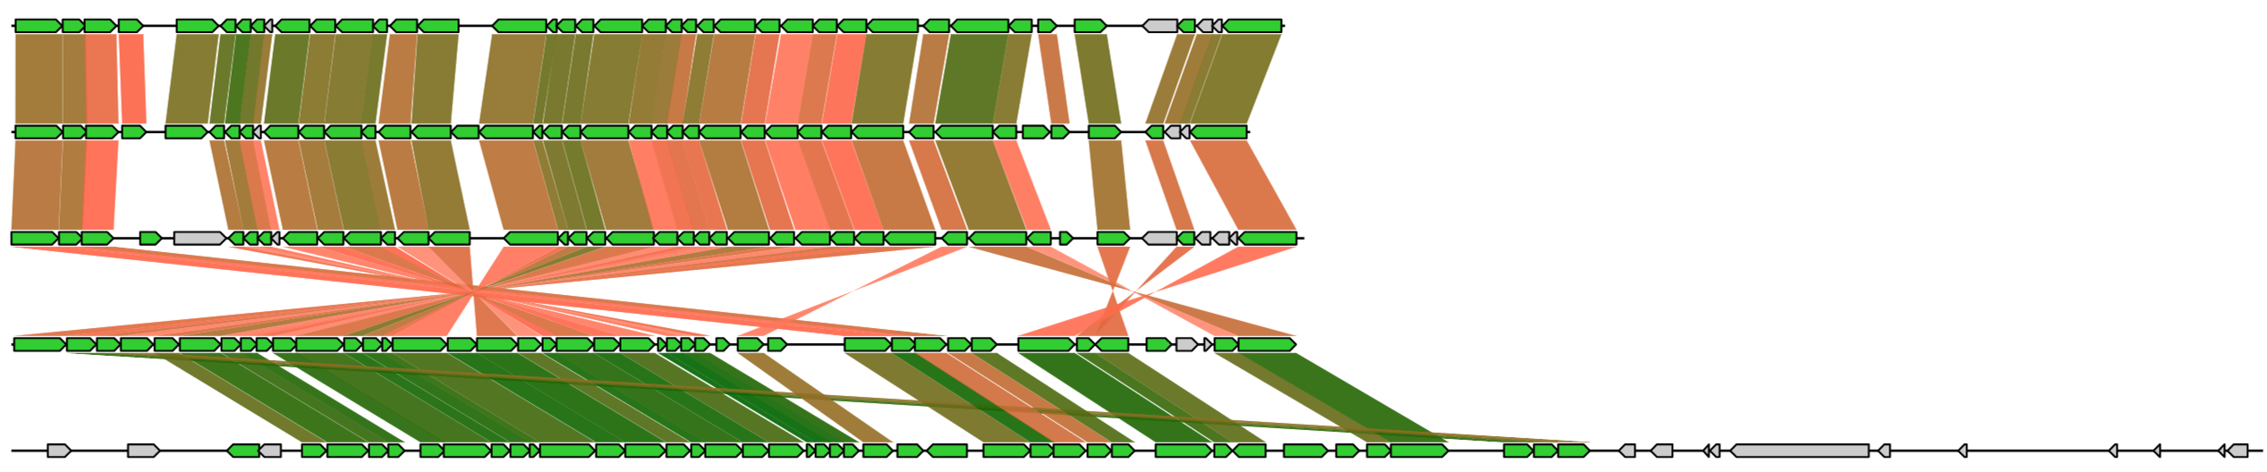
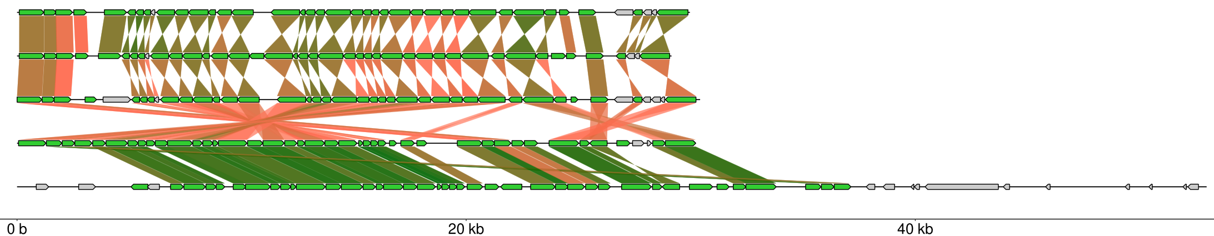
Examples of cp32-like elements with different confidence levels
NZ_CP115597
wGRR = 0.73
Identity:
NZ_CP114697
wGRR = 0.54
Conserved cp32
NZ_CP073149
Other
wGRR = 0.42
NZ_CP019758
wGRR = 0.77
NZ_CP019926
cp32 P-P with high confidence (green box), an element an typical size (low confidence, red box), and cp32-like P-Ps (medium confidence, blue box) from other hosts (NZ_CP115597 and NZ_CP114697 in Borrelia miyamotoi, and NZ_CP073149 in Borrelia nietonii) that were detected only by tyPPing.

Slide 4
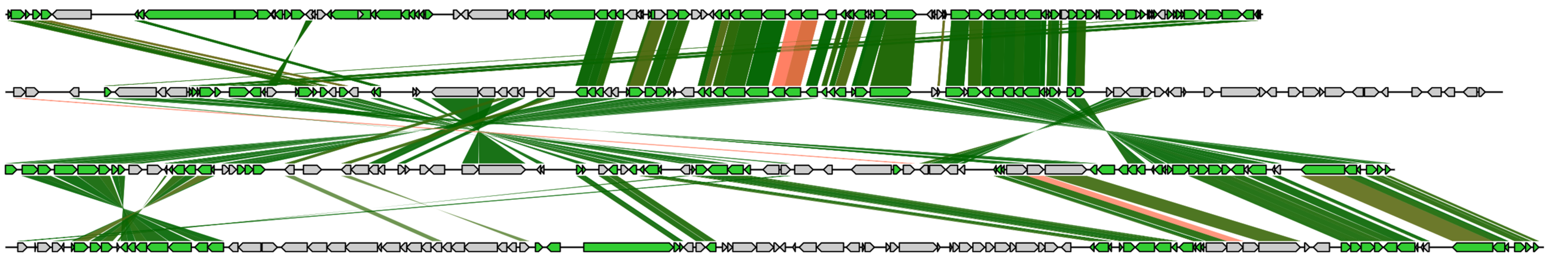
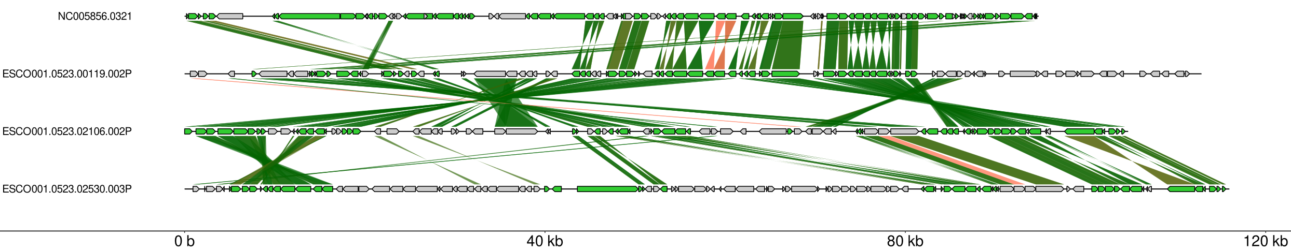
Detection of P1-like plasmids (false-positives) by tyPPing
Conserved P1_1
P1
NC_005856
Other
wGRR = 0.49
Identity:
NZ_CP010146
wGRR = 0.83
NZ_LR883966
wGRR = 0.52
NZ_CP061756
P1 (in green box) is compared to two elements (NZ_CP010146, NZ_LR883966) predicted by tyPPing to belong to P1_1 (medium confidence, red boxes). These elements were characterized as P1-like plasmids (PMID: 38378896), that lack essential phage genes and encode either oriT sequences or relaxases. NZ_CP061756, also a P1-like plasmid, was not detected as P-P by tyPPing.

Slide 5
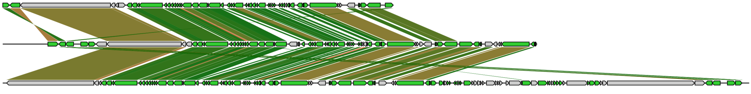
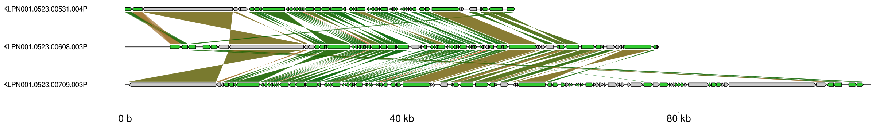
N15 P-Ps detected by tyPPing (low confidence) with too long sizes
Identity:
NZ_CP064249
Conserved N15
wGRR = 0.84
Other
NZ_CP070567
wGRR = 0.80
NZ_CP082016
N15-like P-P with matching size (high confidence, green box), and two N15-like P-Ps (low confidence, red boxes) with inverted duplications (indicated with blue brackets).
Many of the N15-like cases (n=10, >62 kb) contain long inverted repeats of several kilobases. These repeats likely arose through wraparound reads that are commonly reported for linear elements if sequenced by PacBio.

Slide 6
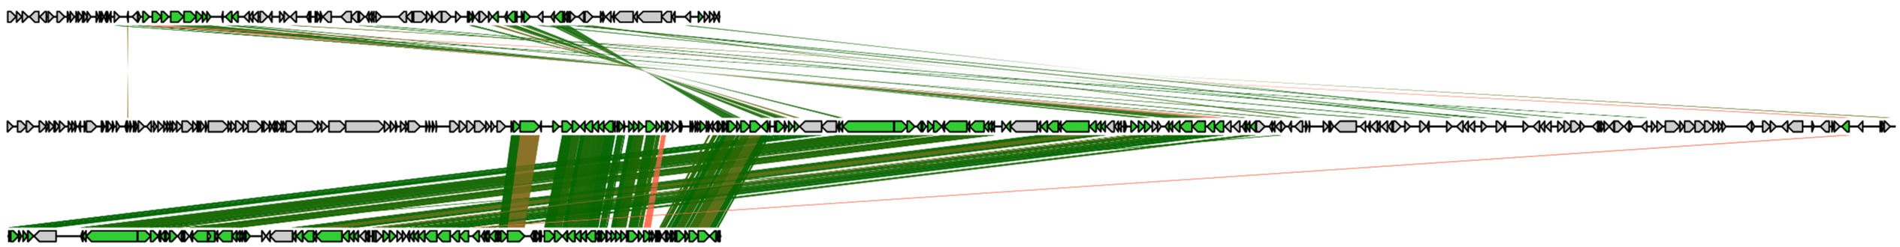
P1_1 low confidence with atypical size (too long)
Identity:
Conserved P1_1
NZ_CP081715
Other
wGRR = 0.35
NZ_CP103719
wGRR = 0.70
P1
NC_005856
An element with conserved P1_1 genes, predicted to be too-long in size (low confidence, red box) in comparison to P1 (green box) and to a related plasmid (NZ_CP081715).

Slide 7

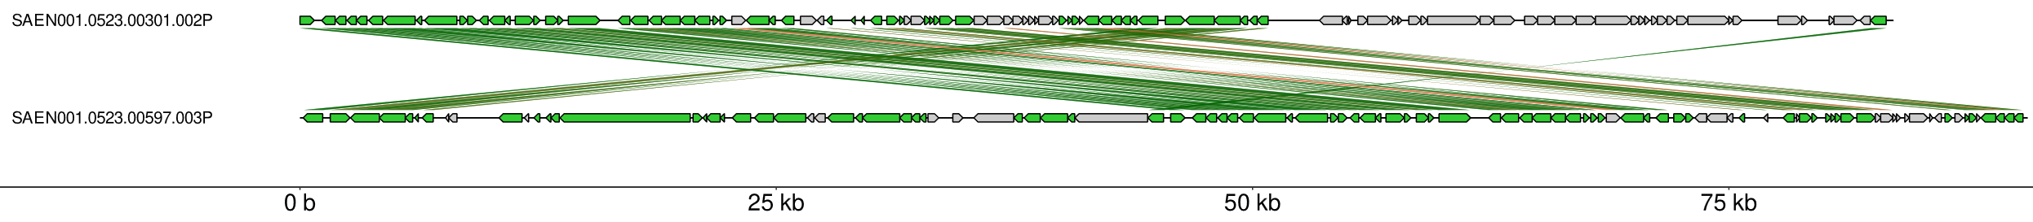
tyPPing predicted one element as P1_2 P-P that misses many P1_2 genes in 05/23 (false positive)
Conserved P1_2
Identity:
Other
NZ_CP100729
wGRR = 0.53
NZ_CP032492
P1_2 P-P (high confidence, green box) and an element predicted as P1_2 P-P (red box) by tyPPing (and vConTACT v2, and geNomad (prophage), but not by MM-GRC).

Slide 8
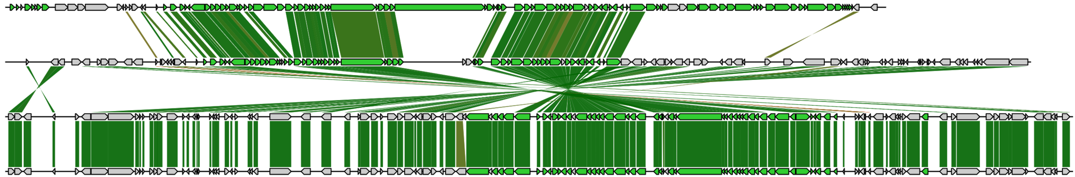
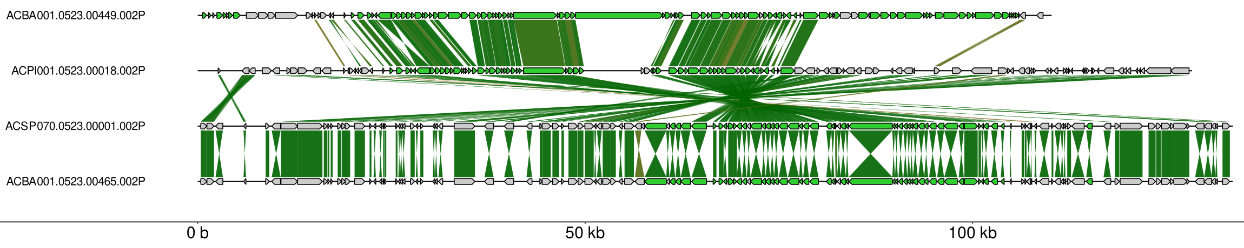
AB_1 cases detected by MM-GRC but not by tyPPing
Identity:
Conserved AB_1
Other
NZ_CP107600
wGRR = 0.51
NZ_CP069498
wGRR = 0.77
NZ_CP102935
wGRR = 1.00
NZ_CP102763
AB_1 (high confidence, NZ_CP107600, green box) and three cases (red boxes) with atypical sizes, and too few hits to conserved protein profiles of AB_1. Detected by MM-GRC, but not by tyPPing.

Slide 9
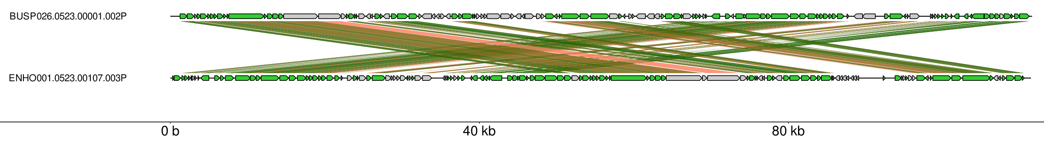
Identity:
SSU5_pHCM2-like P-P not detected by tyPPing (false-negative)
Conserved SSU5_pHCM2
Other
NZ_CP110081
wGRR = 0.61
NZ_CP077310
SSU5_pHCM2-like P-P (high confidence, green box) and a similar P-P (NZ_CP110081, red box) detected by MM-GRC but not by tyPPing.

Slide 10

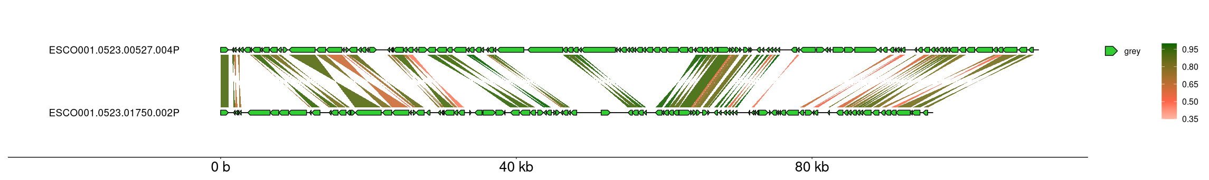
pSLy3-like P-P not detected by tyPPing (false-negative)
Identity:
Conserved pSLy3
Other
NZ_CP031294
wGRR = 0.55
NZ_CP074043
pSLy3-like P-P (high confidence, green box) and a similar P-P (red box) detected by MM-GRC as pSLy3-like, but by tyPPing.

